Slide 1
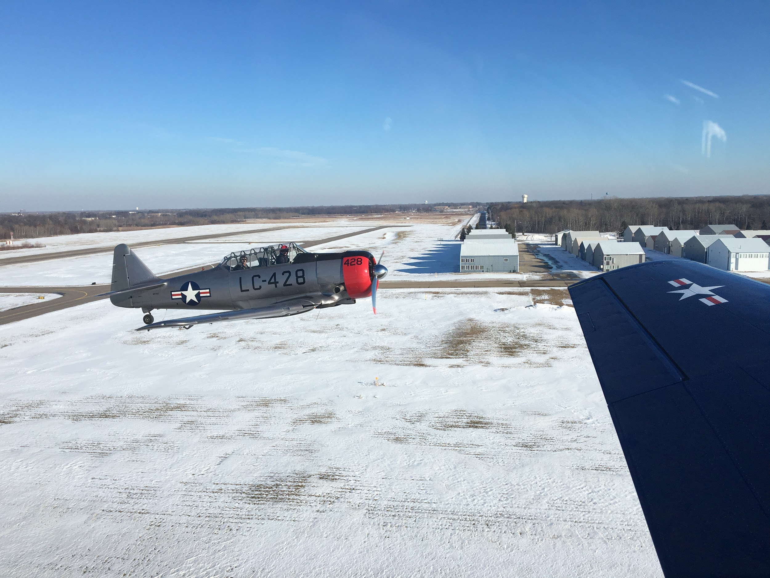
Cold Weather Hazards
&
Cold Weather Safety
Jackson Maddux, MD
Capt. CAP

Slide 2
Cold
Any temperature that can lead to hypothermia given enough exposure.
WHO defines a comfortable temperature range for households as 64-70 F, depending on the condition of the inhabitants (elderly and infants need to be above 70).
Generally, however, the “safe zone” is 40-95 F (if, at 95, the relative humidity is less than 50%)
Moisture & wind play a critical role in affecting tolerance for cold
https://www.livescience.com/34128-limits-human-survival.html

Slide 3
How moisture & wind affect cold tolerance
Moisture allows for much more efficient heat transfer since water has a very high heat capacity and therefore moist air can transfer heat much better than dry air.
Wind creates convective heat transfer and that transfer increases with increased wind speed.

Slide 4
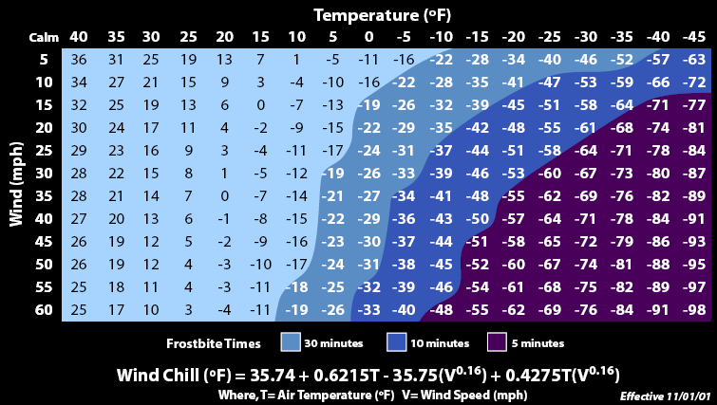
Wind chill: perceived temperature on the body
https://en.wikipedia.org/wiki/Wind_chill

Slide 5
Australian Apparent Temperature
An alternative to wind chill that accounts for the humidity.
Link: https://www.vcalc.com/wiki/rklarsen/Australian+Apparent+Temperature+%28AT%29
Results from 4:30 PM KMSP METAR 3F, RH 55%, 300@16kt
Wind chill = -14 vs. AAT = -25

Slide 6
Hypothermia
Definition: core temperature below 35C (95F)
Three Stages:
Mild (32-35C/89-95F): increased breathing/HR, shivering, increased urination, poor judgement
Moderate (28-32C/82-89F): slow breathing/HR, NO shivering, slurred speech, dilated pupils
Severe (<28C/<82F): severe decreased breathing, non-reactive pupils, muscle rigidity…death

Slide 7
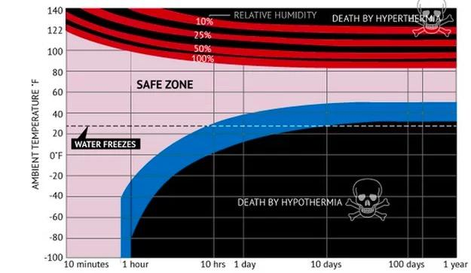

Slide 8
Hypothermia treatment
Remove from the situation
Get out of wind/cold
Remove all wet/sweaty clothes
Warm sweet beverages can help in mild cases
Cover head and neck with blankets once in dry clothes
Limited exercise can help in mild cases
Apply warming packs to armpits, groin, head, neck, chest
Evacuate victim ASAP in all cases that are more than mild

Slide 9
Hypothermia Prevention
Stay Hydrated!!
If your pee is yellow, you aren’t drinking enough
Don’t Sweat!!!
Use multiple Layers
Take off layers as soon as you begin to feel warm (not sweaty)
Replace layers immediately upon stopping activity
Eat more Carbs!!
Carbs supply quicker energy, so carry a snackbar
https://www.cdc.gov/niosh/docs/2010-115/pdfs/2010-115.pdf

Slide 10
Frostbite: Cold temperature’s version of a burn
1st & 2nd degree can both be treated in the field with rapid rewarming (water at 104-108)
-Pale & numb, with redness/pain/blisters on re-warming
3rd & 4th degree WILL result in loss of tissue and risk of infection
-Chunk of wood appearance. Frozen solid. Rewarming results in severe pain and unpleasant appearance (gangrene looking, bloody, swollen like crazy)
NEVER re-warm if there is any chance of the affected part to re-freeze.
NEVER massage or rub the area
Ibuprofen 400mg every 12 hours to prevent formation of inflammatory chemicals that can hinder healing

Slide 11
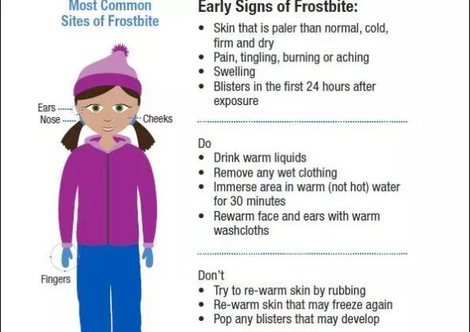

Slide 12
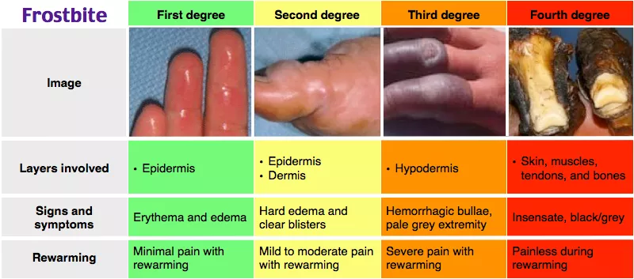
Gross Pictures
https://www.eyeonannapolis.net/2018/01/health-alert-10-below-frostbite-in-30-min/table-frostbite/

Slide 13
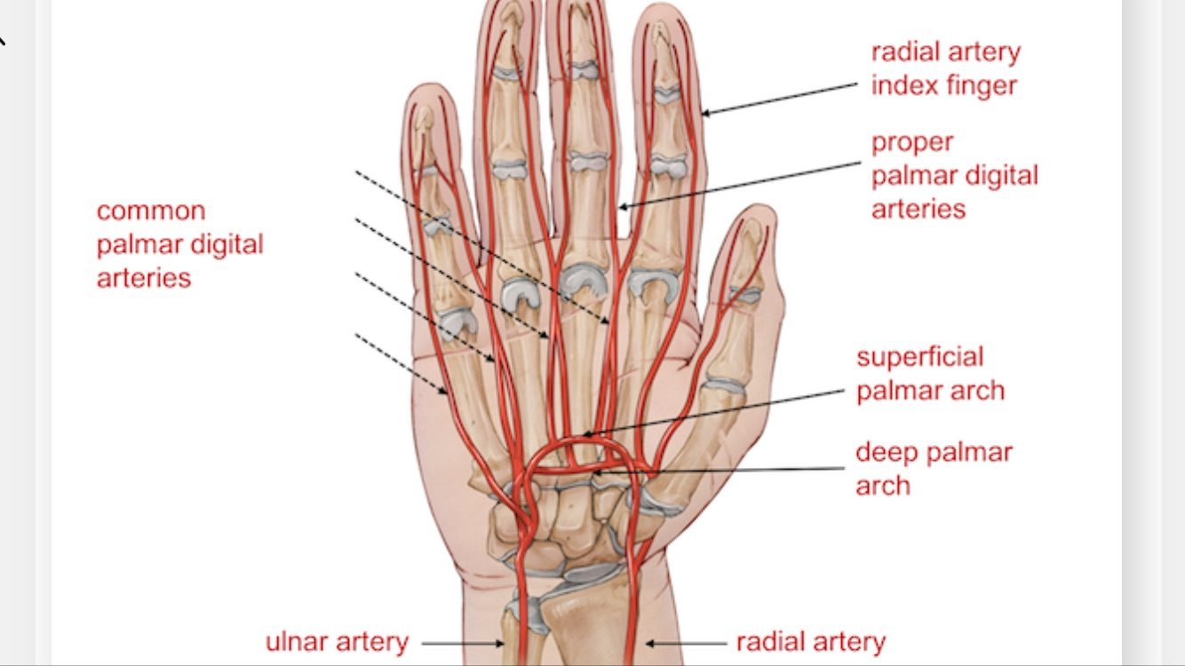
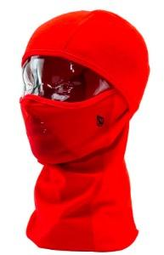
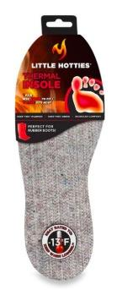
Preventing Frostbite
Have spare dry gloves and wicking socks
Use chemical heat packs on the wrist
Use thermal barrier footbeds
Use mittens instead of Gloves
Use facial AND ear protection
Avoid going outside on extra-cold days
CAP plane: have the clothing needed to
walk several miles.
Battery heated gloves/socks: https://www.thewarmingstore.com/heatedclothing.html

Slide 14
Primary survey for victims found in the Cold
M assive Hemorrhage management
A airway and C-spine stabilization
R espiration
C irculation
H ypothermia/hyperthermia & Hike vs. Helicopter
….and call 911 if able

Slide 15
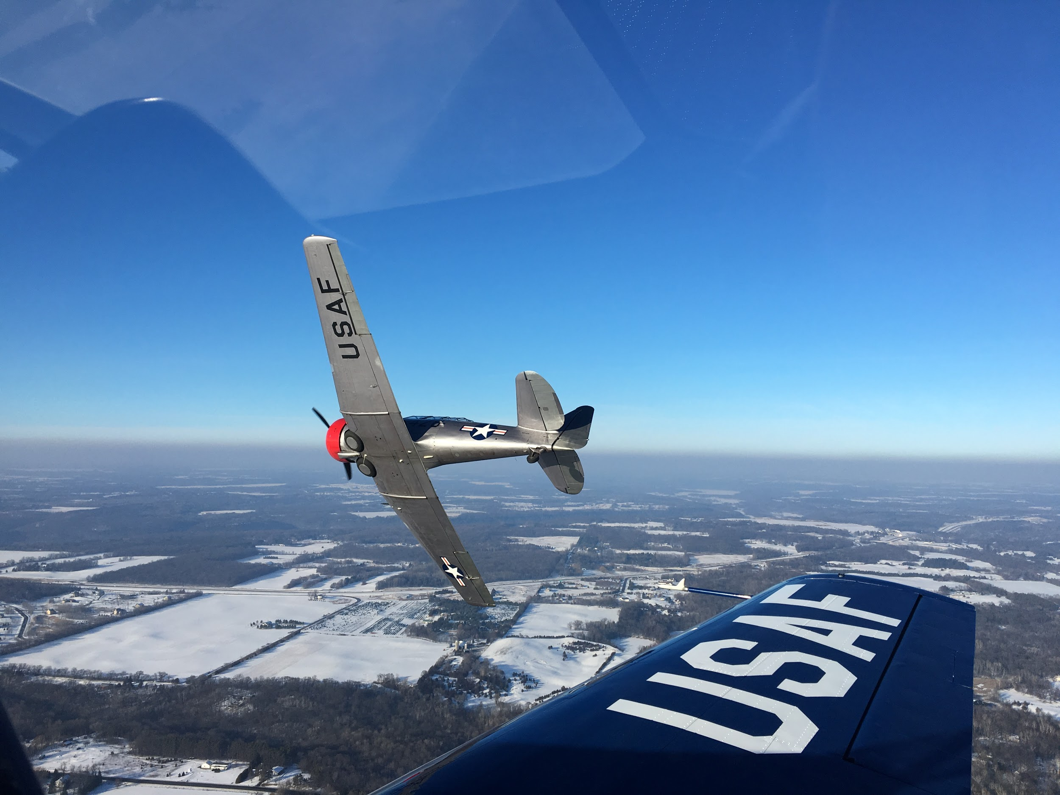
Bye for now!

